Slide 1
Birth of the Cold War

Slide 2
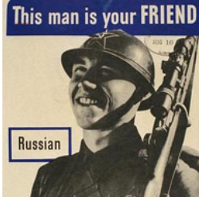
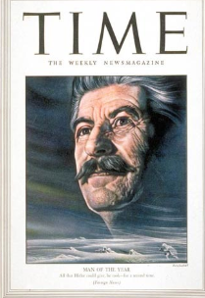
USA USSR Relations World War Two
Pro Russian propaganda…patriotic
And heroic Russian soldiers….legacy
Of suspicion, overcome
Stalin “Uncle Jo”….control of US media ..no mention Camps, Katyn Massacre 1939 ………..Times “Man of Year” 1943

Slide 3
USSR Spy Ring discovered 1946
USA disbands overseas intelligence 1945
….no network of agents within USSR
Canadian/ USA team funded to decipher codes (“Venoma Project”)
Nazi codes 1943-1945
Intercept Soviet codes 1945-46
Multiple KGB Agents identified
Truman needs key speaker to pivot” US
Policy: USSR no longer a friend

Slide 4
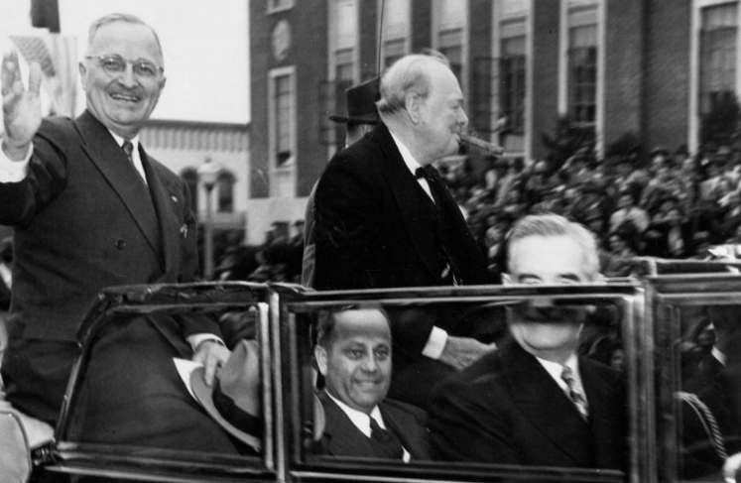
Churchill Westminster College Missouri Speech
Churchill and Truman Fulton
Missouri February 1947
Churchill…out of office, greatly
Respected…huge crowd puller
…media magnet
Iron Curtain Speech
“From Stettin in the Baltic to Trieste in the
Adriatic, an iron curtain has descended
across the Continent. “
Speech profound impact: unites
Republicans and Democrats
The Cold War has begun

Slide 5
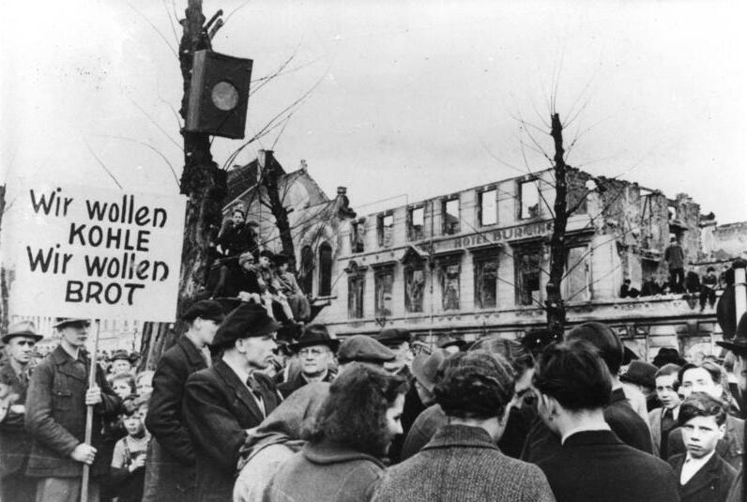
Demonstrations across Europe …..German demonstrations “we want bread”

Slide 6
A collapse of trust
Potsdam Treaty Broken….”free and fair elections” commitment
Rigged elections Poland, Hungary, Romania, Bulgaria 1946
Murders of opposition candidates/ dissappearances
Stalin Bolshoi Ballet Speech February 1946:
“Under the present capitalist conditions of world economic development another World War is inevitable. The United States and Great Britain will eventually clash over their imperial ambitions. And after they do, they’ll try to take out the Soviet Union”..…calls for rearmament, sacrifices, inevitable victory of Marxist Leninism
Lands like “hand grenade in US State Department: US Diplomat John Kennan ….. produces “Long Telegram”

Slide 7
Exit the British
Britain and Greek Civil War
British invasion 1944/ German retreat/ communists Resistance seek power
British support “discredited” monarchy/ conservatives civil war 1946-1948
Turkey demands equal aid…threatens to join USSR
British financial crisis 1947: announces withdrawal, aid cut off
Global commitments….debts/ diminished resources, use of British Indian Army
Bankruptcy avoided by US loan…but commitment t NHS , nationalisation
Implications to USA: Europe will be “lost” to Communists unless USA acts
Something must be done or gains from war vs Totalitarianism will be lost

Slide 8
Intermission

Slide 9
Long Telegram George Kennan 1946
USSR expansionist power with no intention of reconciling with West
Will never give up Eastern Europe, will attempt take over Western Europe
USSR risk averse, rely on third parties, infiltration of institutions and propaganda
Direct military confrontation unnecessary: policy of containment
USSR will eventually collapse due to economy and division
US success dependent on strong successful allies under US leadership
Truman studies and agrees : sets US foreign policy 1946-2025

Slide 10
The response: Truman Doctrine Truman Joint Session of Congress March 12, 1947
“At the present time in world history nearly every nation must choose between two alternative ways of life. The choice is not a free one.
One way of life is based on the will of the majority, and is distinguished by free institutions, representative government, free elections, guarantees of individual liberty, freedom of speech and religion, and freedom from political oppression.
The second way of life is based on the will of a minority forcibly imposed upon the majority. It relies on terror and oppression, a controlled press and radio, fixed election, and the suppression of personal freedoms.
I believe that it must be the policy of the United States to support free peoples who are resisting attempted subjugation by armed minorities or by outside pressure.
I believe that we must assist free people to work out their own destinies in their own ways. I believe our help should be primarily through economic and financial aid which is essential to economic stability.”

Slide 11
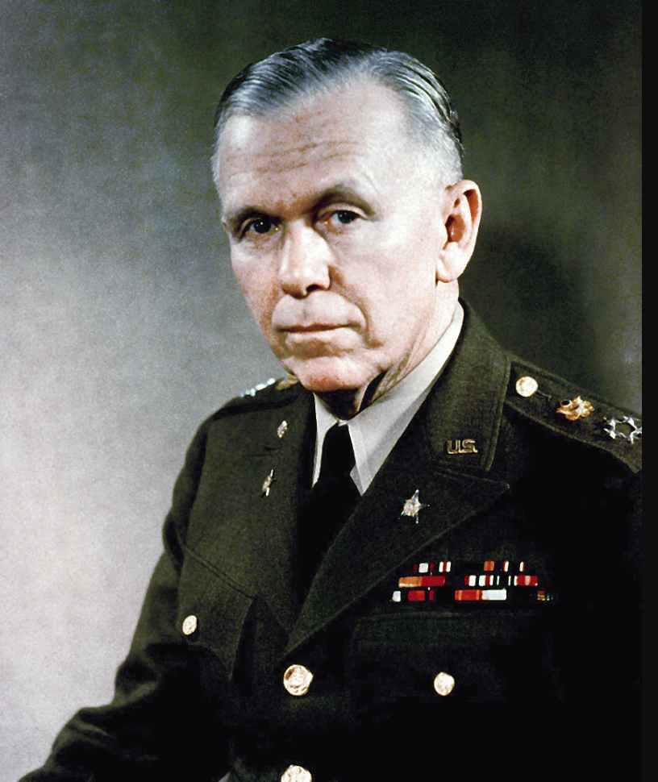
George Marshall US Secretary of State
George Marshall 1880-1959…as Chairman Joint Chief of Staff
)
Career soldier@ Phillipines War WW1…assigned to China…fluent in Mandarin
Rises up ranks 1930’s.
……supporter of New Deal
Chief of staff WW2….antagonist of
MacArthur, supports Eisenhower
Special Envoy China…attempt to broker peace CCP & KMT
Secretary of State…ruman to develop
US European strategy

Slide 12
Marshall Plan 1947-1952
Europe to collapse to USSR unless hunger/ poverty solved
“natural recovery” to take up to 10 years….too late/slow
Marshall Plan
185 $Bn ($2024 value) provided to buy US goods and food
Includes plan to re-industrialise Germany
Abolition of trade barriers across Europe
Offered to all European countries….including USSR and Eastern Europe
USSR response
Rejects…capitalist trap/ but has to move beyond “looting”
Develops alternative “Comintern Plan”

Slide 13
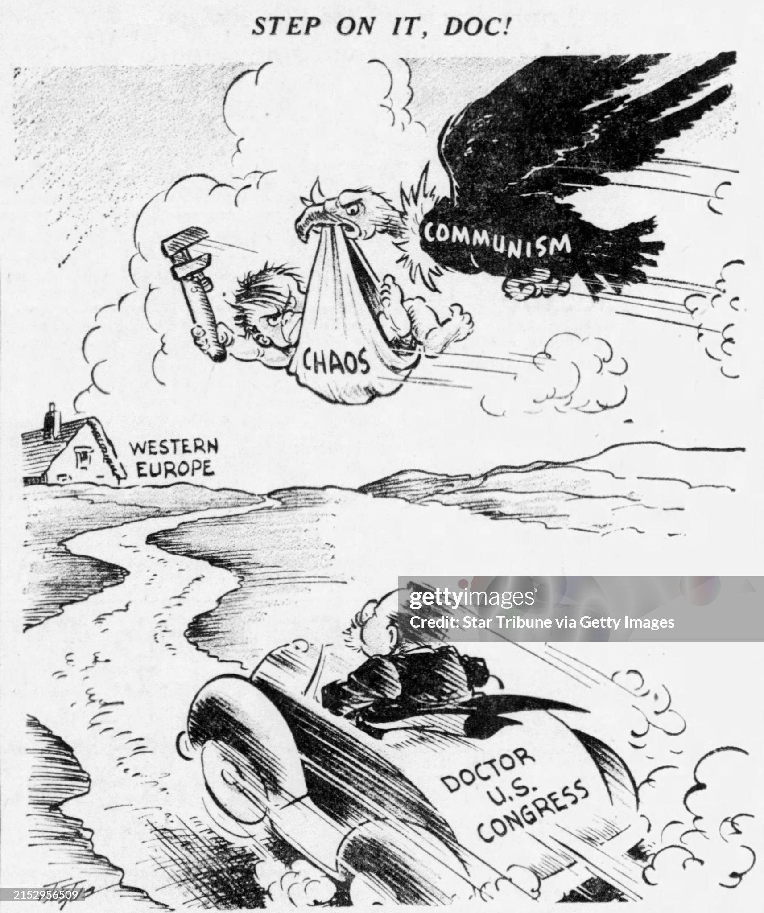
Marshall Plan sails through Congress ….Bi Partisan Support

Slide 14
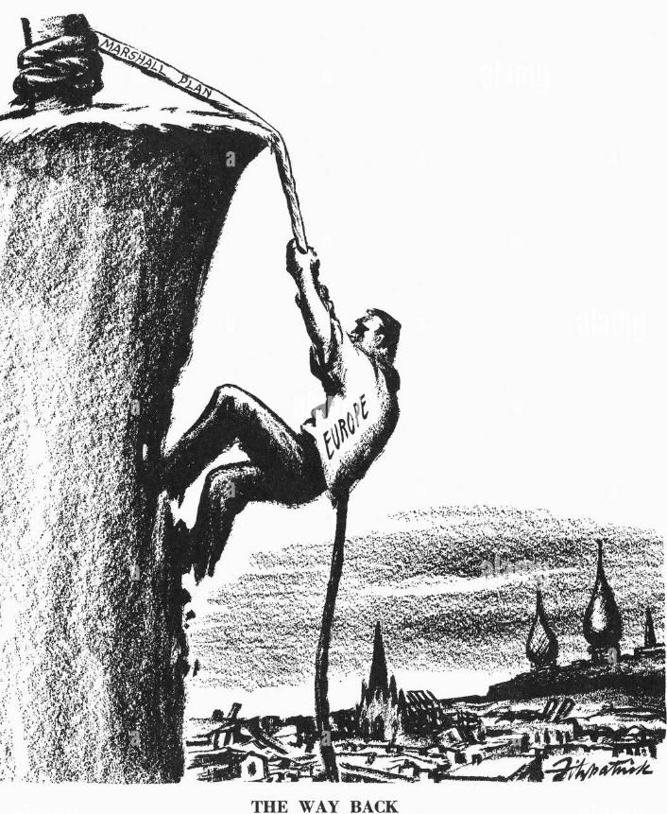
An easy sell

Slide 15
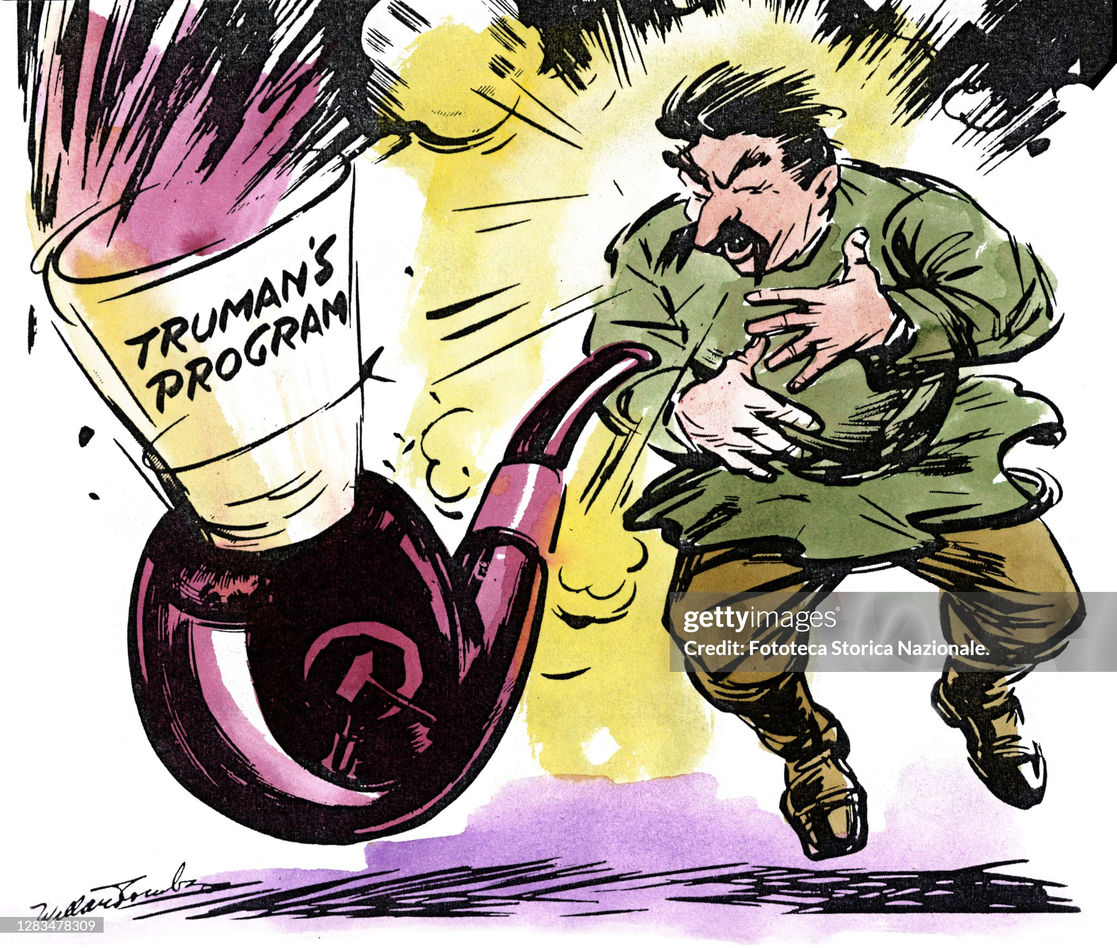
Selling the plan….anti communist

Slide 16
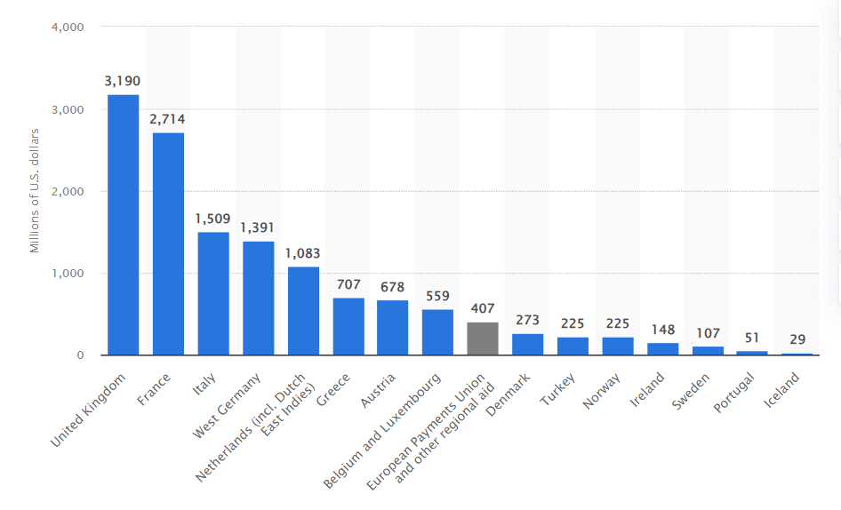
Marshall aid deployed across
Marshall Plan Aid 1949-1952

Slide 17
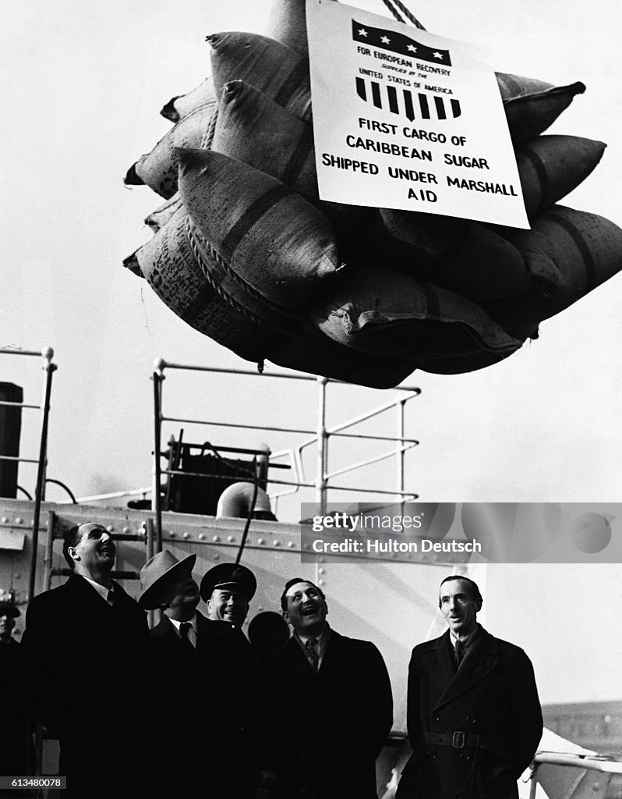
Marshall Aid: Sugar for Britain

Slide 18
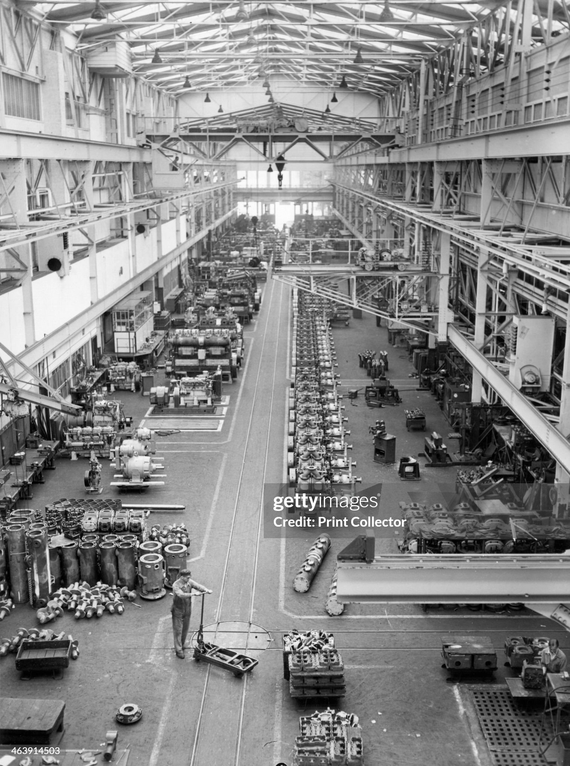
Diesel manufacturing facility: Netherlands

Slide 19
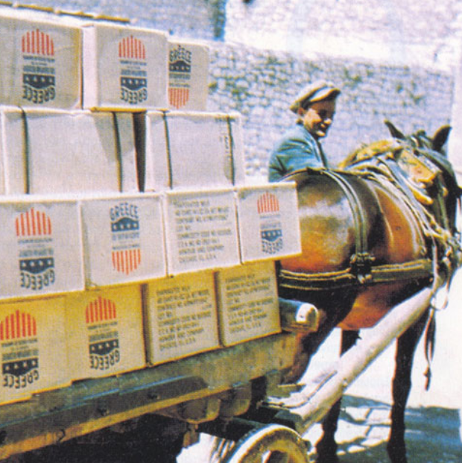
Mules (size issue) …and food to Greece

Slide 20
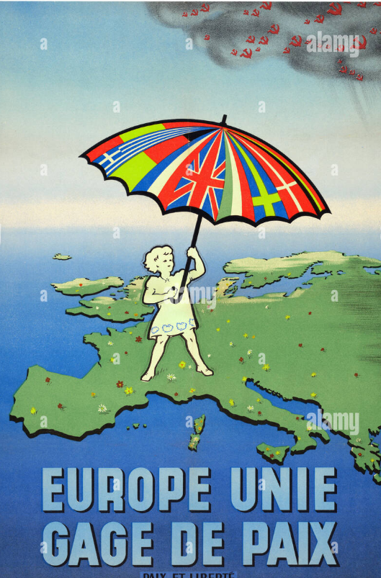
Plan included funding of anti communist propaganda & Christian Democrat Parties

Slide 21
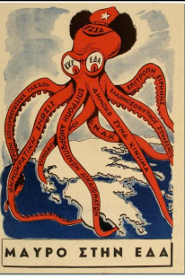
Greek anti communists propaganda

Slide 22
Impact of Marshall Plan
Western Europe
Risk of starvation, hunger eliminated fast…..confidence returned
Communists lose elections Greece & Italy
French Communists excluded from coalition
Economies recovery accelerates.
Eastern Europe
Left behind…countries seek to join…USSR compels rejection
Czechoslovakia (last) free elelection ….attempt to join Marshall plan
USSR response….coup of 1948
Czech leadership imprisoned or murdered
Stalin decides on power play: force Allies to evacuate Berlin

Slide 23
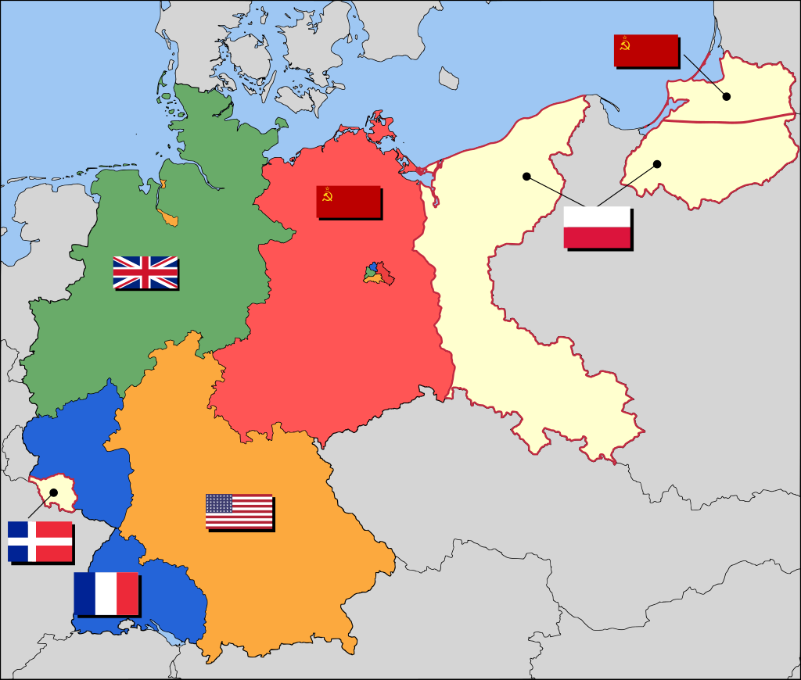
Occupied Germany 1948 and Berlin
British/ US reduced armies
…cooperation between zones
…local gov returned
…marshall plan begun
Berlin
Russian.
…army control/ punishment main focus
…policy of “loot”
50,000
Down 75%
1,500,00
(unchanged)
150,000
(Unchanged)
Berlin:
US. UK/ French/ USSR zones
Free travel within
one highway in/ out
200,000
(Down 76%))

Slide 24
Berlin Blockade (April 1948-May 1949)
Triggers
New currency / economic recovery
Anti communist elections 1946
USSR decision
Stalin “as goes Berlin, goes Germany, goes Europe”
Close Highway/ Railroads/ cut off water ..June 1948
Allied Dilemma:
10,000 troops Berlin vs 100,000 Russians..30 days supply of food
Berlin not worth a war…options considered: attack, use atomic bomb
US/UK decide to feed city of 2 million by air..no matter cost, time

Slide 25
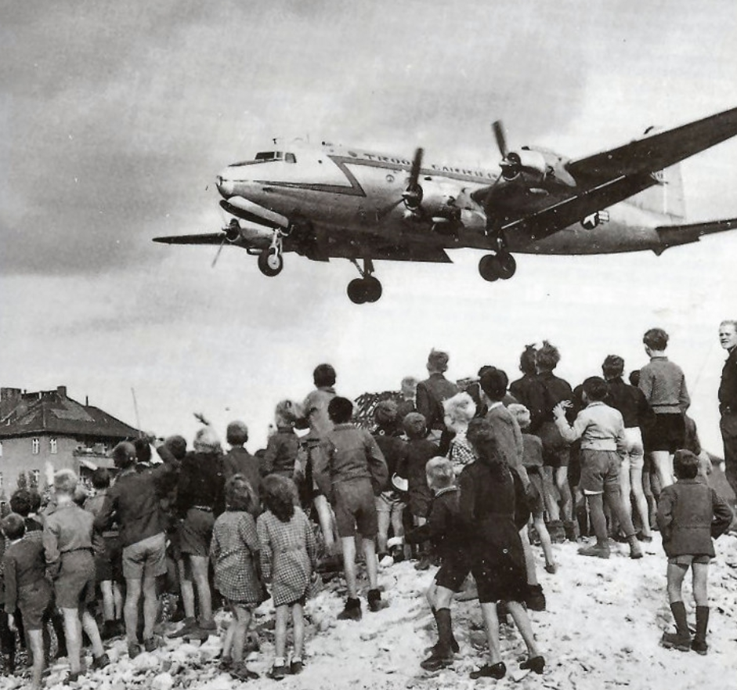
Children watch plan arrival

Slide 26
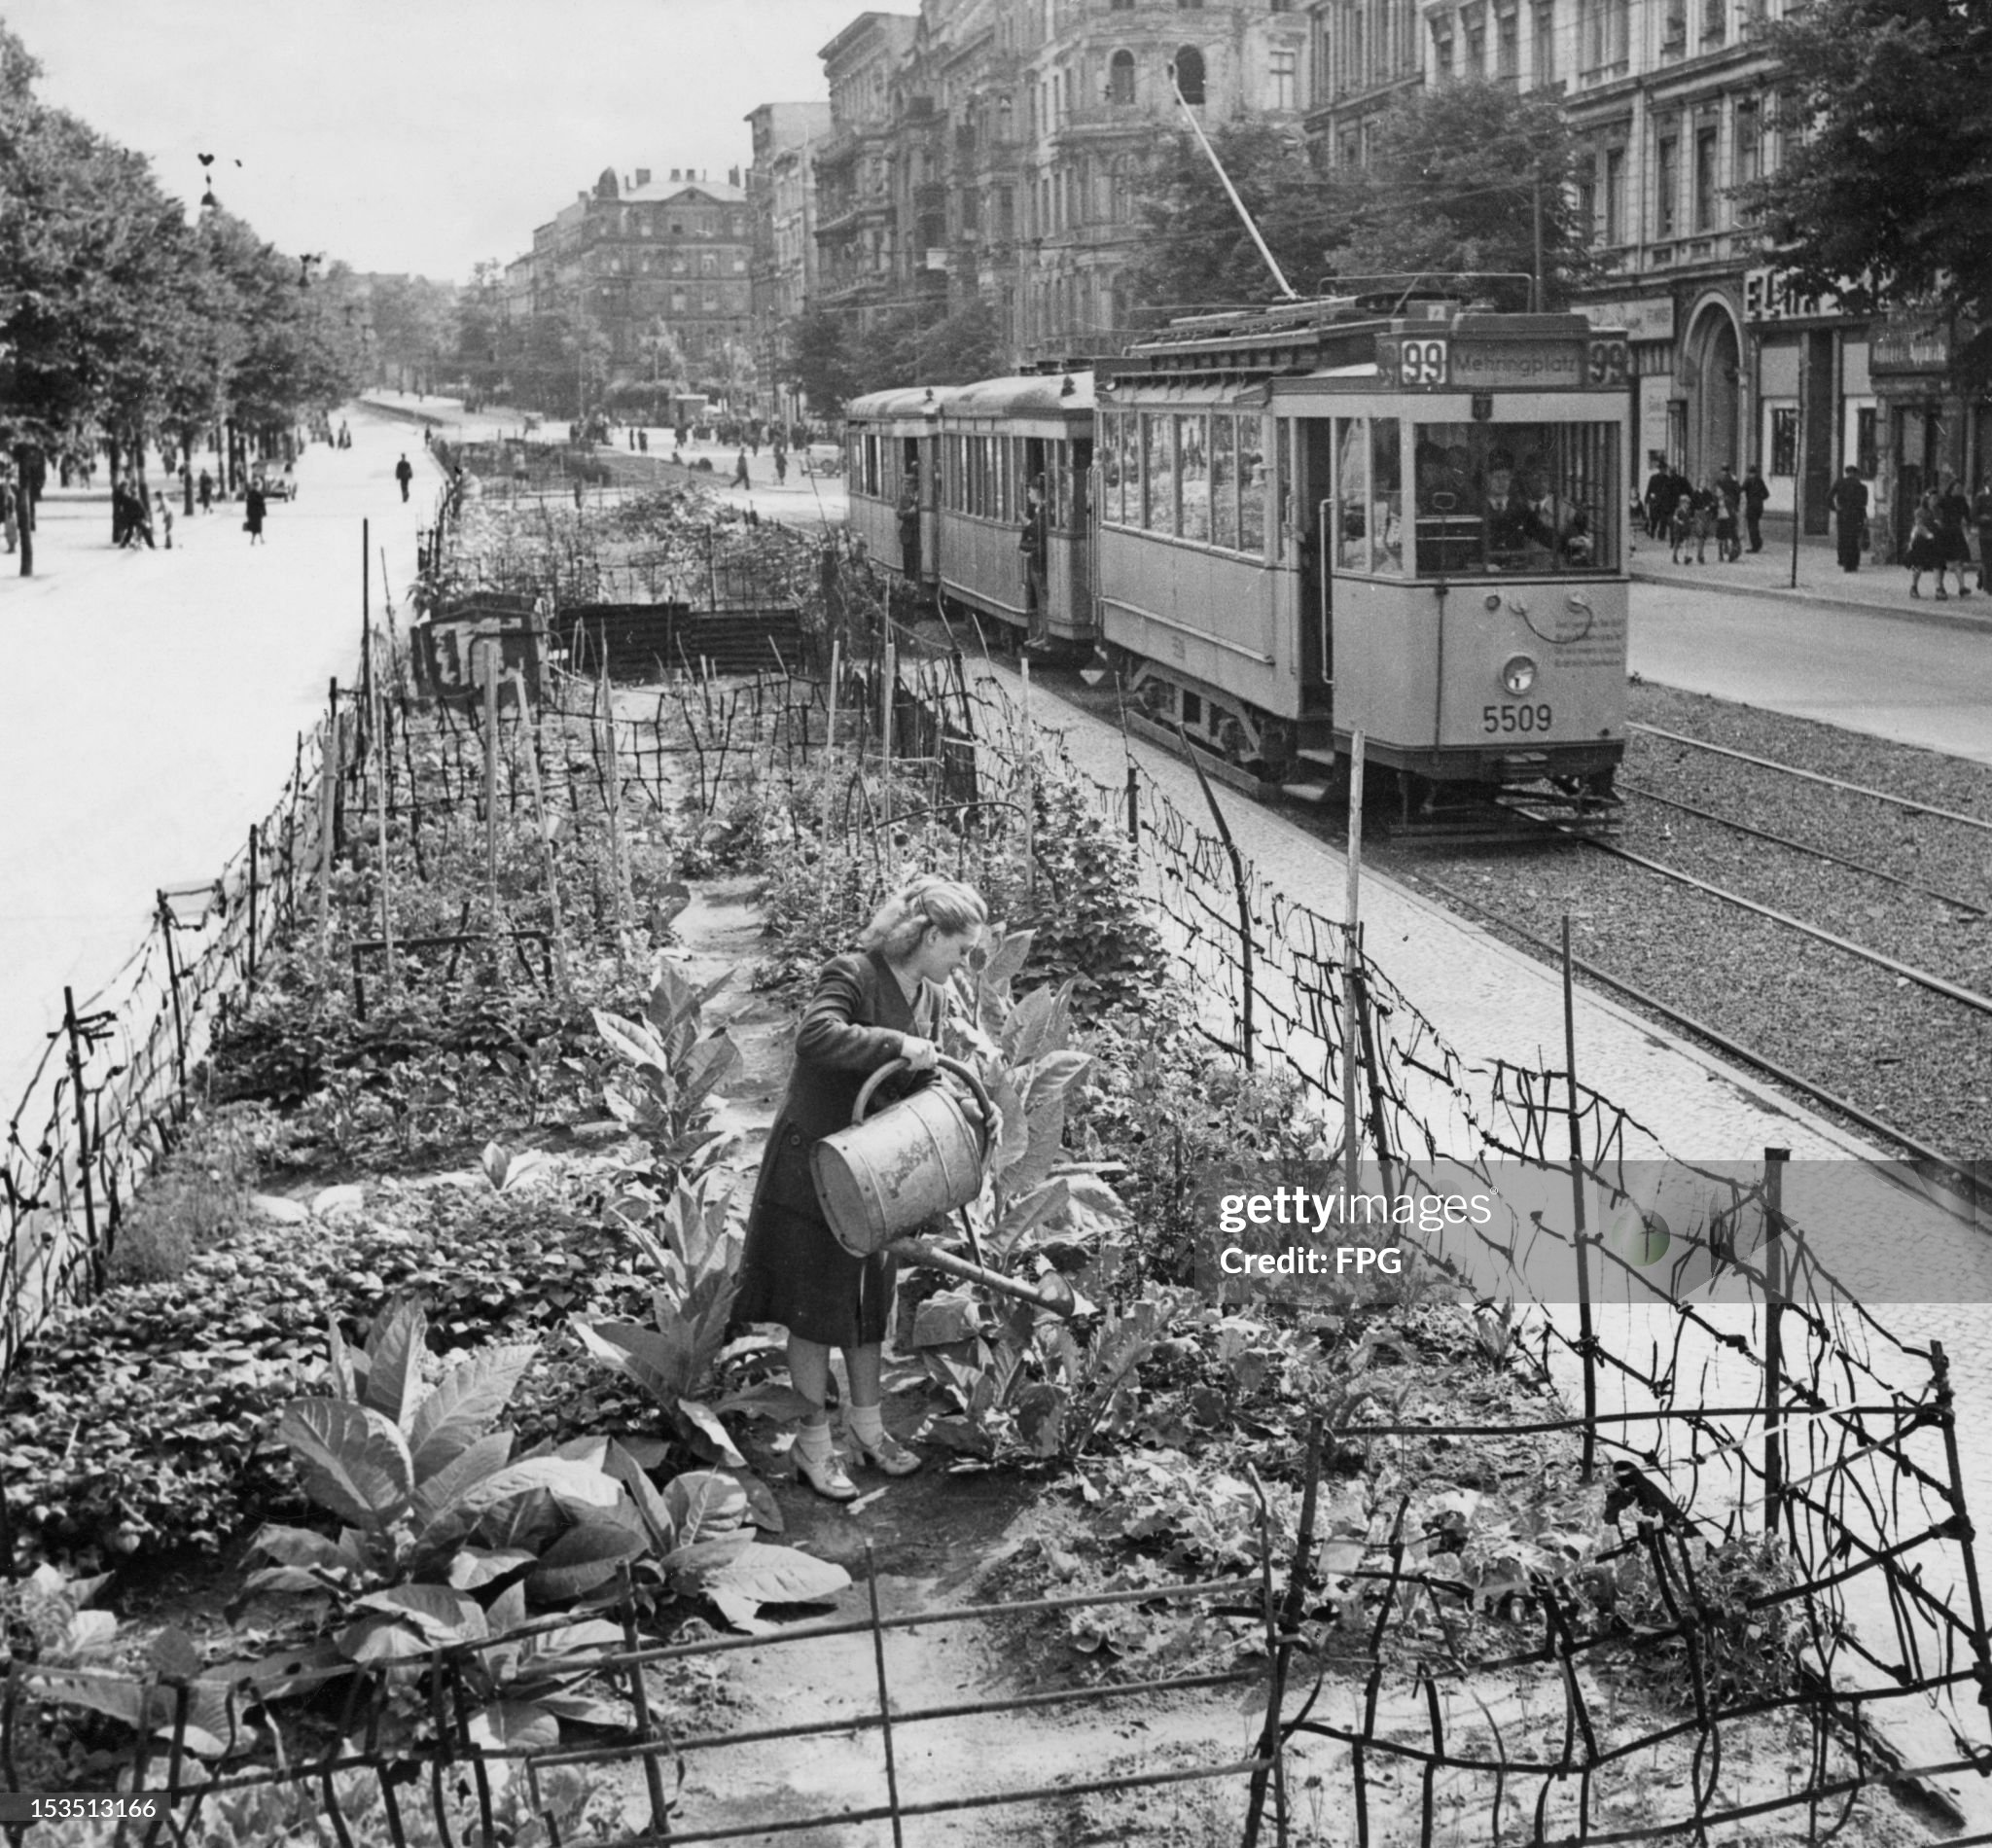
Berlin survival….allotments in tramways

Slide 27
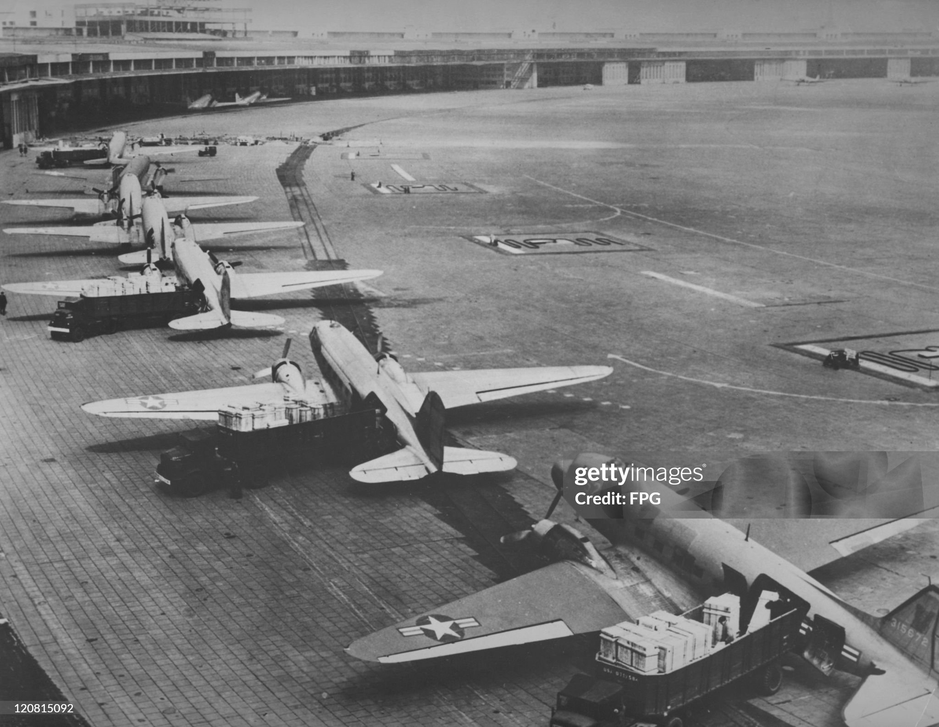
Flights increase to 1,500 per day..4,500 tons of cargo……one plane every 90 seconds…great success,

Slide 28
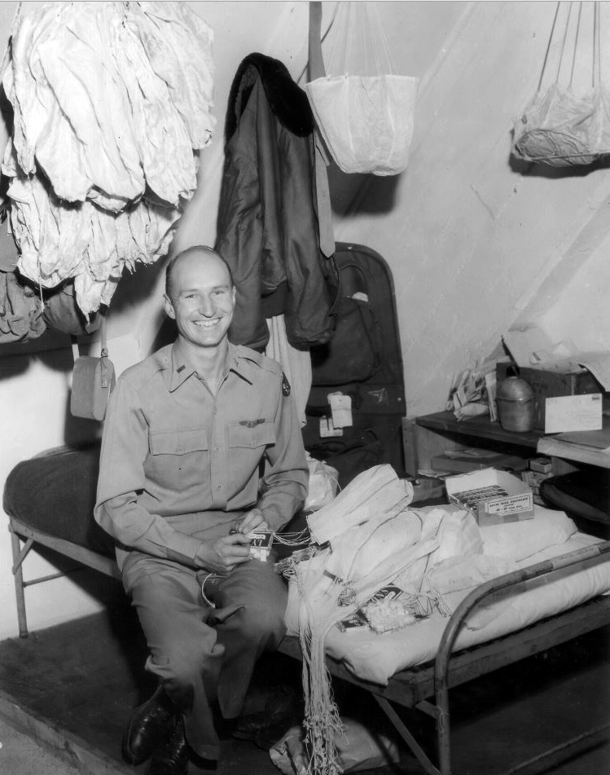
“Little Vittles”
Gail Holvorsen
Hands out candy to
German children
Children share, not grab
Candies..children ask when will
He return…will wiggle wings
Children send letters to USAF
…”Mr Wiggle Wings”
Publicity spread
US children send candy bars

Slide 29
Berlin Airlift Aftermath
Berlin saved
City survives…residents fed, heated, clothed
Communists/ USSR discredited
USSR
Cannot risk war
Ridicules airlift till feasibility proven
Abandons blockade May 1949
Allies decide to form German government and end Occupation of American, French and British zones
Cold War “victory” in Berlin offset by events in China

Slide 30
Trouble in China

Slide 31
China 1900-1937
Collapse of Central Authority 1840-1911: “unequal treaties”
Revolution and chaos 1911-1932
Qing Dynasty overthrown/ Republic established
No united government :
National Government (Chiang Kai -Schek): KMT
Communists (Mao Zedong) : CCP
Multiple warlords ( and Japanese puppets)
Japanese invasions: Manchuria 1932/ Coast and Eastern China 1937
KMT & CCP “unite” 1937 vs Japan….distrust and duplicity continues thru war

Slide 32
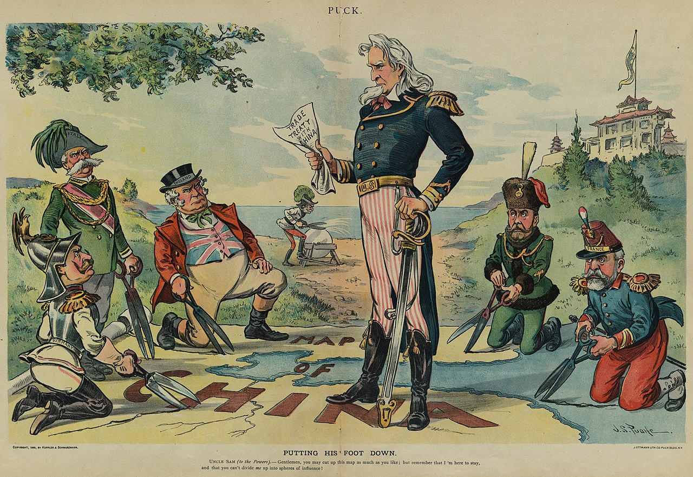
US and China
US self image as “honest broker”
China …future for US trade
“Open Door Policy” no one
nation to dominate
US self image “Protector” China, its markets a “prize” for its Mastery of Pacific”
Wants united, capitalist China
Support “China” vs Japan
Aids KMT only

Slide 33
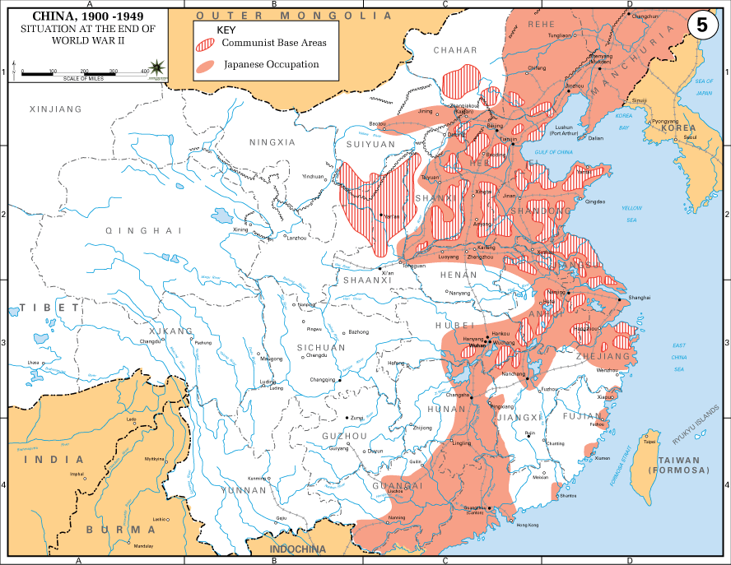
China at end of World War Two
Stalemate: …Japanese control
North coast…1944 offensive fails
….move troops to mainland
USA delivers aid to KMT, via Burma
…throughout war…USSR no support
…treaty with Japan
KMT control inland, army of 5m
Supplied by USA and USSR
Army mix of ex warlords,conscripts
CCP control mountains, countryside
Army 1m but highly motivated
USSR invades North, Japanese
Army of 600K surrender to USSR
gives arms to CCP

Slide 34
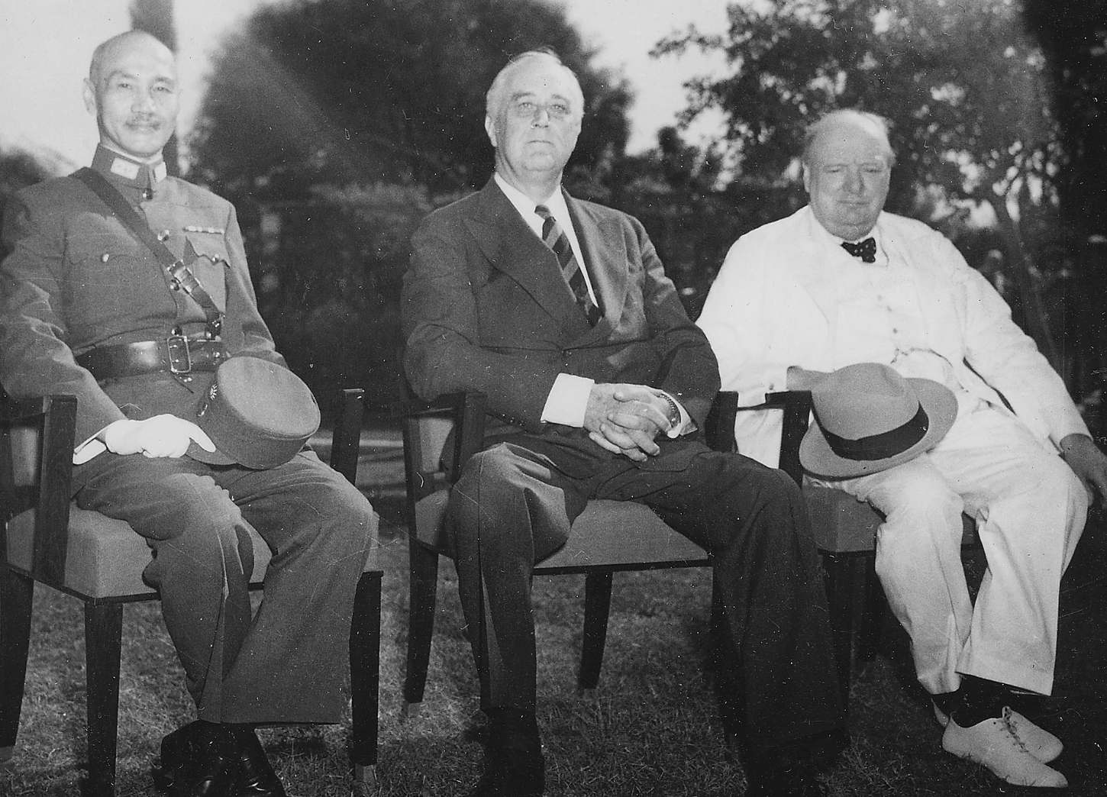
China 1945: US/ UK recognise Chiang Kai -Shek ….…China seat on UN Security Council …….US view: “China saved”

Slide 35
China 1945
Widespread devastation…18 million deaths, starvation:
US sends 50,000 army to support KMT/ repatriate Japanese prisoners
Civil war resumes fight to control land abandoned by Japan
Government unstable, unpopular
Chaing Kai- Shek not seen as “victor”…war won by USA and USSR
Rampant corruption “Cash my Check)…deals with ex warlords
FDR/ Truman sends Sec of Defense Marshall to establish “Unity Government

Slide 36
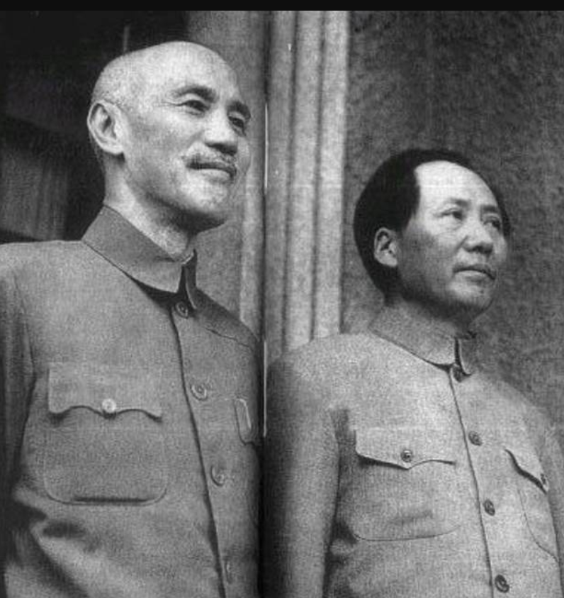
Peace Conference 1945
Chiang Kai - Shek
Mao Zedong
Marshall seeks
Chaing Agreements
…land reforms
…free elections
…coalition government”..
Marshall loses faith In Chaing
...cuts US aid/ withdraws army
….no progress Mao (USSR
Civil War resumes

Slide 37
Chinese Civil War 1945-1949
KMT and CCP rush to occupy land occupied by Japanese
USSR support Mao Zedong/ US reduces aid to Chaing
Nationalist support (KMT) collapses
Inflation/ Corruption
Desertion…army reduced to 1m by 1949
CCP rises in popularity and power
Gains support of peasants: Land reform (80% of Chinese peasants)
Army grows to 5m plus
KMT defeated by 1949, retreat to Taiwan…protected by US fleet
Truman blamed for “losing China”…“soft on communism”
…..US Politics shaped for next decade

Slide 38
1948 Election and Cold War

Slide 39
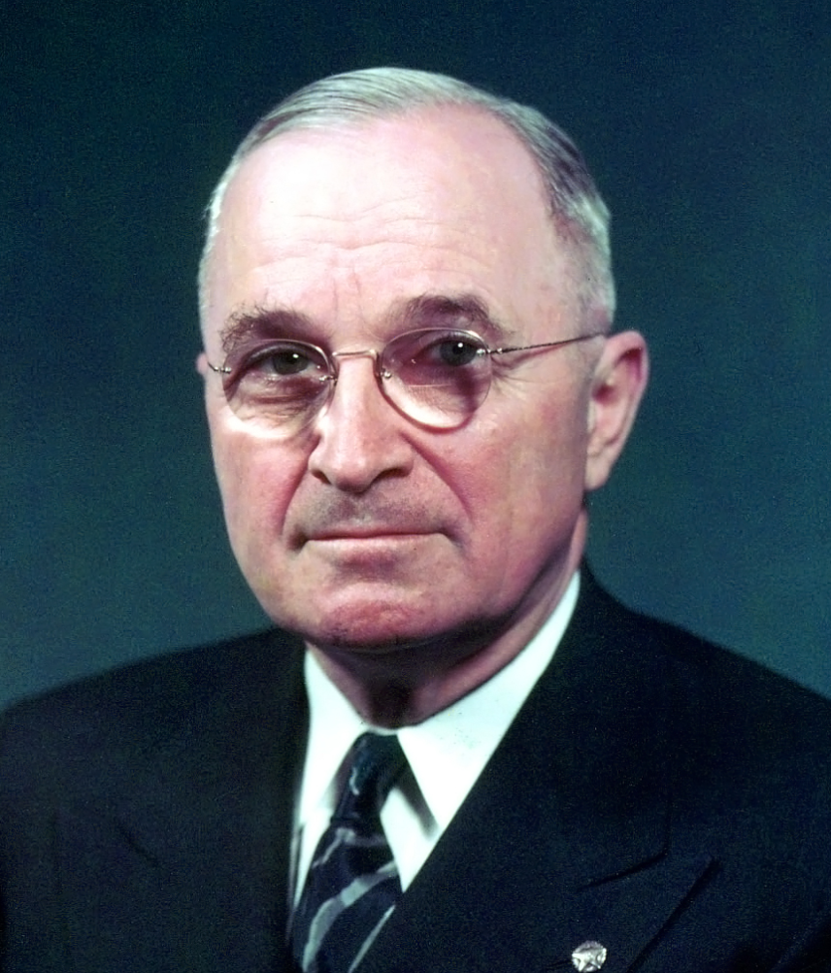
1948 election
From Missouri Grandparents slave owners
Harry Truman 1882-1972
Kansas City ‘machine” politics
elections..competitive thuggery
No personal enrichment
…father in- law foreclosure
Voracious reader/ good pianist
No International background …and yet ..decision to use bomb..Marshall Plan/ Berlin Airlift
New Deal reformer…use
government to help the people

Slide 40
Truman quotes
My choice early in life was either to be a piano player in a whorehouse or a politician. To tell the truth, there's hardly a difference.
I can remember when a good politician had to be 75 percent ability and 25 percent actor, but I can well see the day when the reverse could be true.
A pessimist is one who makes difficulties of his opportunities and an optimist is one who makes opportunities of his difficulties
We must face the fact that peace must be built on power, as well as upon good will and good deeds.

Slide 41
Truman and race
As 27 year old farmer ““I think one man is just as good as another so long as he’s honest and decent and not a nigger or a Chinaman… I am strongly of the opinion that negros (sic) ought to be in Africa, yellow men in Asia and white men in Europe and America.”
Remains white supremacist/ uses racist words but views change
At 65…as President after lynching of black GI’s in uniform ““My stomach turned over when I learned that Negro soldiers, just back from overseas, were being dumped out of army trucks in Mississippi and beaten,” Truman said. “Whatever my inclinations as a native of Missouri might have been, as president I know this is bad. I shall fight to end evils like this.”

Slide 42
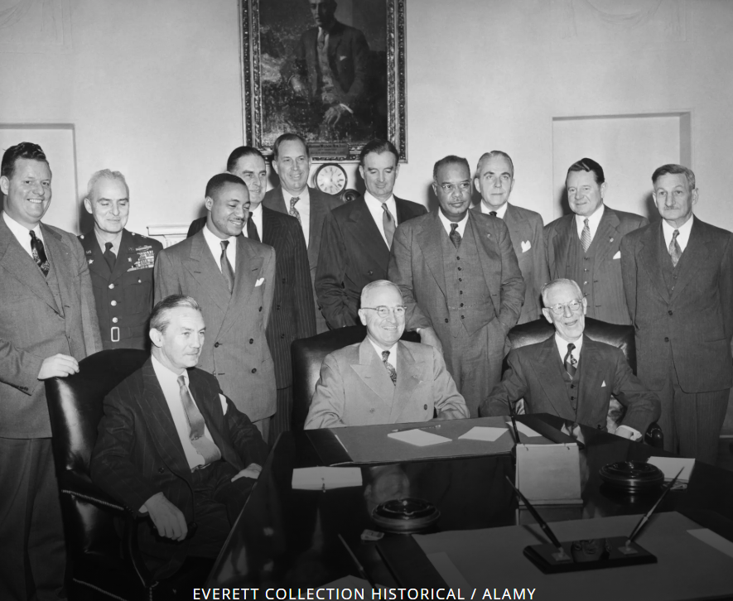
Executive Order 9981..ending discrimination in military ..1948….army resists…not in effect till 1954

Slide 43
Election campaign
Truman seeks second (full) term
offers “Fair Deal”: the politics of abundance
Compulsory national health insurance plan/ guaranteed jobs scheme
Seeks minority support: Northern blacks…Civil Rights/ Jews ..new state of Israel
Fear of communism drives election
Truman introduces Loyalty Oath….all Federal employees…3,000 out of 1 million terminated
Sets up Central Intelligence:
Democratic Party splits over civil rights and anti communism
Dixiecrats (White Supremacists0 ….replace Democrats in South: no ”Solid South” Progressive Party …splits northern vote..liberal

Slide 44
Truman appears doomed
Republicans pick Thomas Dewey
…..Progressive Conservative
…..Election result obvious…say nothing but platitudes
…….”You know your future is still ahead of you” !
Republican feed off strikes of 1946: pass anti union “Taft Hartley” law
Bans closed shops
Allows Right to Work (i.e. no union) States
Truman vetoes bill but Senate overrides
Truman…”the man who lost China”, Marshal/ FDR Russian “dupe , pro union

Slide 45
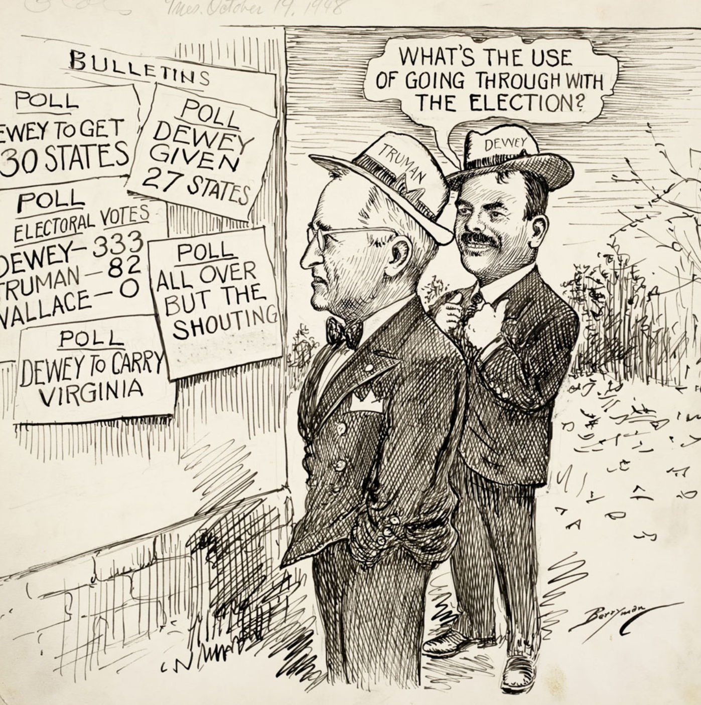
The campaign: a forgone conclusion

Slide 46
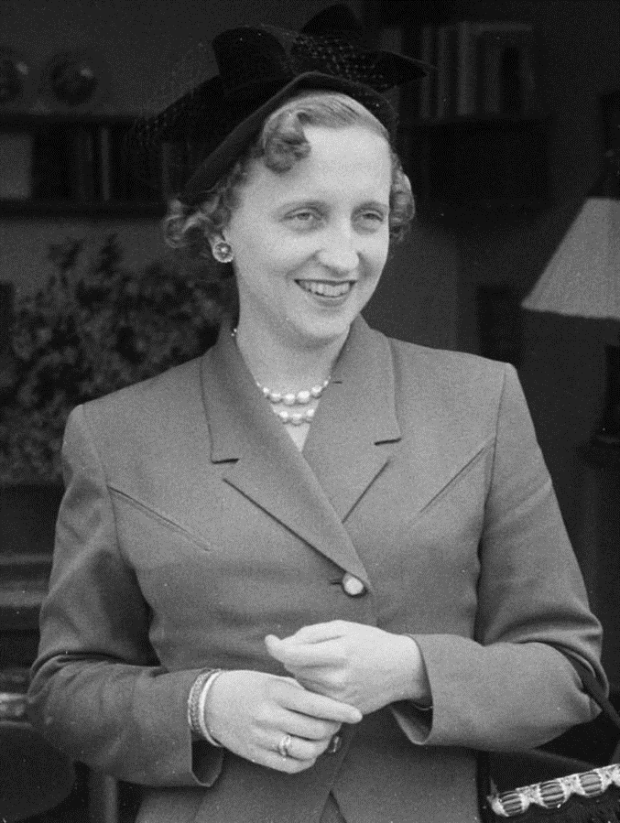
Truman “road show”: Bess and Margaret
Truman a family man: “Three things ruin a
man: power, money, and women. I never
wanted power. I never had any money,
and the only woman in my life is up at the house right now.” .. married 55 years!
Margaret Truman 1924-2008)
Margaret only daughter
…opera singer career
…Truman promotes to major opera houses
…considered good, not great
Truman 1948 aggressive campaign:
…Speech by Harry “Give em Hell Harry”
…song by Margaret/ …duet Harry & Margaret
…then “meet the Boss”..Bess
Margaret marries….successful writer of
Murder mysteries (“murder in Havana”
“murder at CIA…murder at Pentagon,
Murder at Congress”

Slide 47
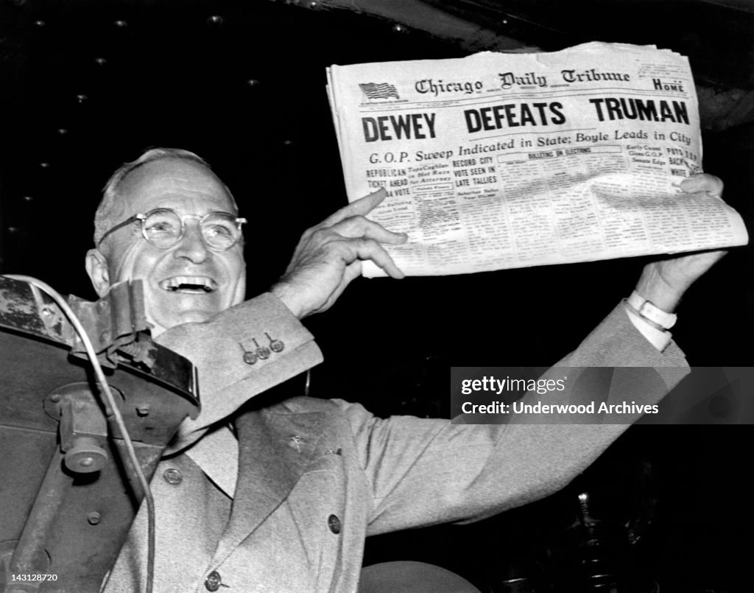
The joys of beating the polls

Slide 48
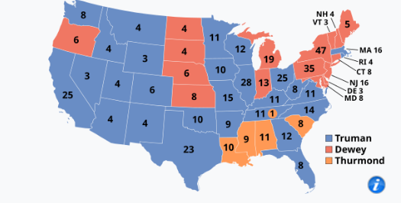
Result….biggest surprise till Trump
Truman wins college
Dem 303, Rep 189, Dixicrats 39
Wins popular vote by 2m
…49% vote vs 45%
Democrats lose “Solid South”
First time since civl war
….due to civil rights initiatives
Dems lose NY…8% vote to Progressives
Win Detroit (Michigan)
Chicago, Illinois

Slide 49
Election aftermath
Democrats regain control of house, Republicans the Senate
“Fair Deal” dies in committee
Cold war intensifies
US/UK agree to create “West Germany”
Japan and West Germany to be reindustrialised
Nato established April 1949 military alliance
“Unamerican Activites” Committee in Senate steps up pressure…spy network
Then on August 29th 1949 something completely unexpected

Slide 50
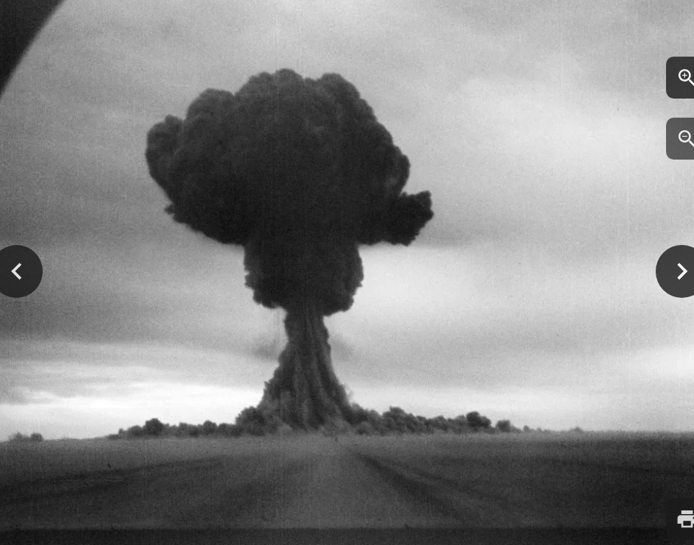
Russian Atomic bomb

Slide 51
Next talk34: USA during the 1950’s.. March 17th
Then Talk 35: The cold war during the 1950’s

